Slide 1
Medical Officer of Health Updates
Dr. Natalie Bocking
Medical Officer of Health/CEO
October 17th, 2024 | 10:00am
Notes:
- The thin gray line bordering the page stops by ‘Lead’ and needs to carry through to end of corner

Slide 2
Medical Officer of Health Updates
Respiratory Season Updates
Community Health Data Dashboards
  Respiratory Infections Dashboard
  Mental Health Dashboard
  Substance Overdose Profile Dashboard
International Plowing Match 2024 (IPM)

Slide 3
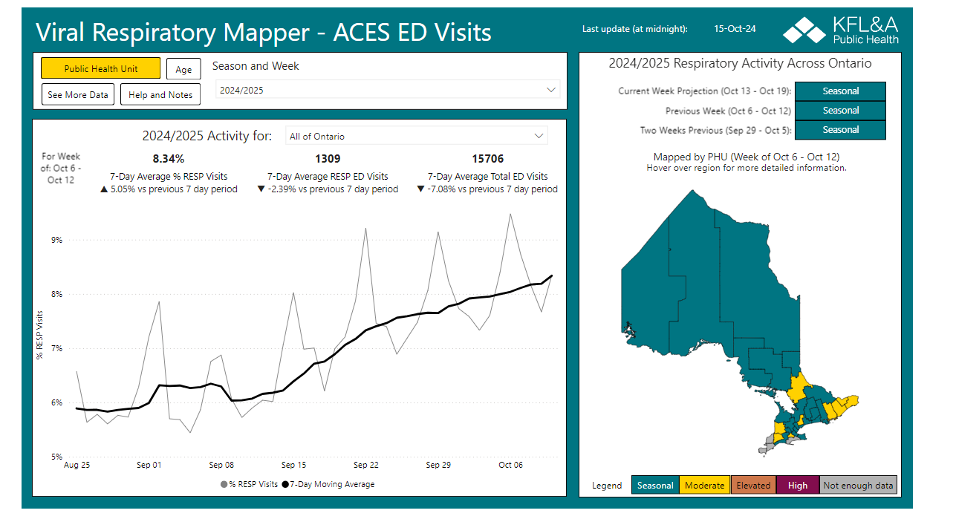
Respiratory Season Updates

Slide 4



Community Health Data Dashboards
Respiratory Infections Dashboard
  Tracks activity of COVID-19, influenza, RSV, and other respiratory viruses.
Mental Health Dashboard
  Mental health indicators from the latest Canadian Community Health Survey (CCHS) alongside local data on emergency department visits and hospitalizations related to mental health.
Substance Overdose Profile Dashboard
  Data on substance overdose-related harms in the HKPR District including emergency department visits, hospitalizations, and deaths.

Slide 5
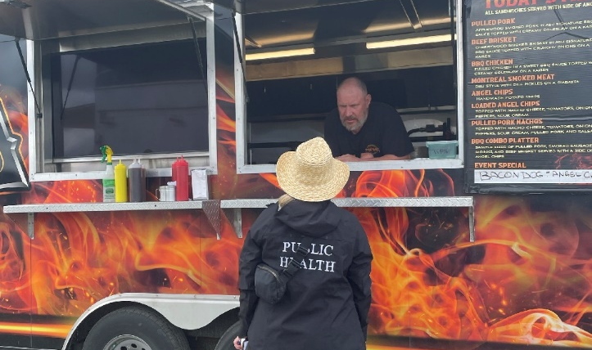
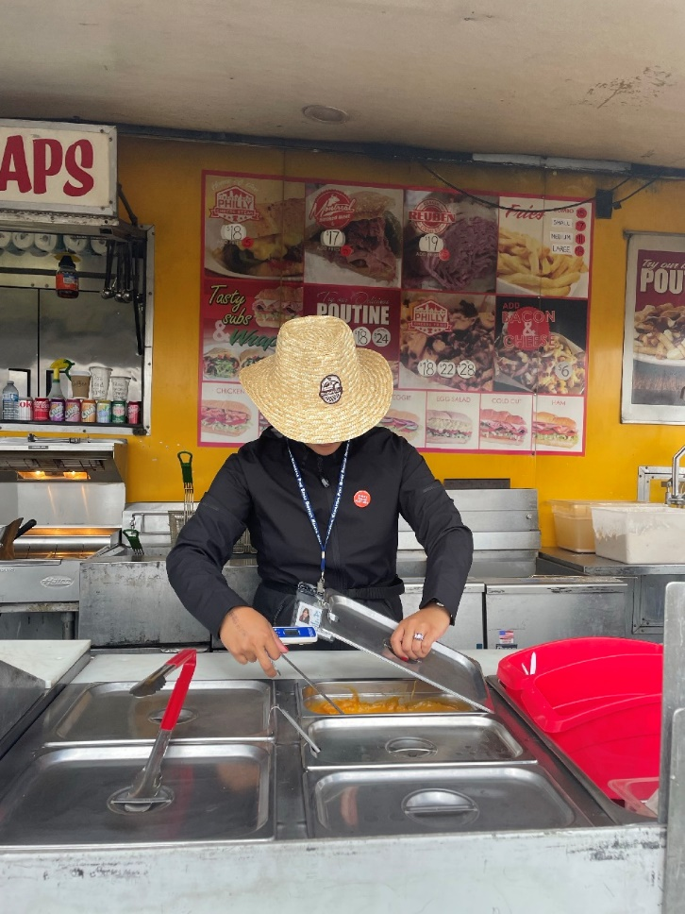

International Plowing Match
58 Food Inspections/Re-inspection
72 Chlorine checks on distribution lines
24 Bacteriological water samples collected
No smoking / no vaping signage checks, education and issued some warnings
Example Issues:
Lawn mower ran over distribution pipe
Water pipe in RV park came apart
Various hot holding and reheating infractions observed and corrected
Dozen warnings issued for smoking
Notes:
City of Kawartha Lakes hosted the 105th annual International Plowing Match (IPM) and Rural Expo, a five-day celebration of agriculture and rural living.
Expected over 70,000 people, 1,500 RV camping sites and over 200 exhibitors/vendors

Slide 6
‘Healthy People, Healthy Communities.’
Reach Out to Us
1-866-888-4577
info@hkpr.on.ca
hkpr.on.ca

