Slide 1
Mental Health Promotion Framework
Dearbhla Lynch, MSc & Joanne Brewster, MSW
on behalf of the Mental Health Promotion Working Group
June 20, 2024
Notes:
- The thin gray line bordering the page stops by ‘Lead’ and needs to carry through to end of corner

Slide 2
Presentation Outline
Purpose and goals of the HKPRDHU Mental Health Promotion Framework
Framework development
Next steps

Slide 3
The Mental Health Promotion (MHP) Framework
Purpose and goals: Operationalizing the MHP Guideline
To identify factors influencing mental health and provide a structure for understanding and planning how we can promote and protect mental health and well-being in our communities.
To implement the Framework across the organization thus creating a public health workforce that understands MHP, can effectively use strategies and approaches, and can incorporate their knowledge and skills into practices, programs, and services.

Slide 4
Framework Development
Evidence-Informed and Engagement
1
2
3
4
5
6
7
Established project working group
Reviewed other public health mental health promotion frameworks
Hosted two virtual
forums inviting community partners working in the field
Created summary of evidence
Drafted Public Health Action Areas
Engaged internal and external partners in review, invited feedback
Incorporated feedback into final framework

Slide 5
Framework development
1
2
Established project working group
Reviewed other public health mental health promotion frameworks
Fall of 2022
Representing Health Promotion and Foundational Standards Divisions
Reviewed several existing frameworks, all developed pre-covid

Slide 6
Framework development
3
4
Hosted two virtual
forums inviting
community partners working in the field
Created summary of evidence
Evidence from research, best practice, and guidance documents from sources such as Centre for Addiction and Mental Health, Canadian Mental Health Assocation, World Health Organization
February and March 2023
Thirty-six individuals representing 22 agencies across HKPR region

Slide 7
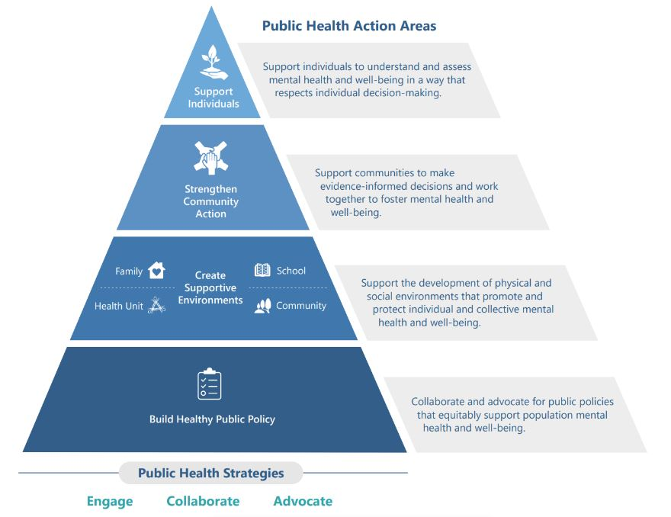
Framework development
5
Drafted Public Health Action Areas

Slide 8
Framework development
6
7
Engaged internal and external partners in review, invited feedback
Incorporated feedback into final framework
Twenty individuals reviewed the draft public health action areas in the framework

Slide 9
Next steps…
Building organizational capacity
  Identify and support skills and competencies required to
  ensure mental health promotion is embedded into
  public health practices, programs and services.
  Integration of the framework into the planning process
    Support the integration of mental health promotion into all public health programs and services.

Slide 10
‘Healthy People, Healthy Communities.’
Reach Out to Us
1-866-888-4577
info@hkpr.on.ca
hkpr.on.ca

